Slide 1

RAJALAKSHMI INSTITUTE OF TECHNOLOGY Data Structures and Algorithms Session 1- Introduction to Data Structures

Slide 2
Data Structure - Introduction
Computing systems are continuously performing tasks on data other than the primitive data of the operating system.
There must therefore be a system for the computing system to determine how to best implement and organize memory of abstract data types and how to efficiently implement various operations using specific algorithms.
Data structures provide this organization; they are the physical implementation of abstract data types which are generated by specific procedures.
A data structure will consist of both a collection of variables for storing data as well as algorithms for implementing operations.

Slide 3
Data Structure
A data structure is a group of data elements that provides the easiest way to store and perform different actions on the data of the computer.
A data structure is a particular way of organizing data in a computer so that it can be used effectively. The idea is to reduce the space and time complexities of different tasks.

Slide 4
How Data Structure varies from Data Type
Data Type | Data Structure
The data type is the form of a variable to which a value can be assigned. It defines that the particular variable will assign the values of the given data type only. | Data structure is a collection of different kinds of data. That entire data can be represented using an object and can be used throughout the program.
It can hold value but not data. Therefore, it is dataless. | It can hold multiple types of data within a single object.
The implementation of a data type is known as abstract implementation. | Data structure implementation is known as concrete implementation.
There is no time complexity | Time complexity plays an important role.
In the case of data types, the value of data is not stored because it only represents the type of data that can be stored. | While in the case of data structures, the data and its value acquire the space in the computer’s main memory. Also, a data structure can hold different kinds and types of data within one single object.
Examples are int, float, double, etc. | Examples are stack, queue, tree, etc.

Slide 5
Need for Data Structure
Why data structures are important?
Data organization: Data structures provide a way to organize and structure data in a logical and efficient manner. They enable efficient access, retrieval, and manipulation of data, which is crucial for solving complex problems and building efficient algorithms.
Efficiency: By choosing appropriate data structures, you can optimize the performance of your programs. Different data structures have different time and space complexities for operations such as searching, insertion, deletion, and sorting.
Memory management: Data structures help manage memory efficiently. They allow you to allocate and deallocate memory dynamically as needed, reducing wastage and optimizing memory usage.
Regenerate response

Slide 6
Need for Data Structure
Problem solving: Data structures provide powerful tools for solving a wide range of problems. They enable you to represent complex relationships between data elements, model real-world scenarios, and design algorithms that efficiently manipulate the data. (Sorting, searching, graph traversal, or any other problem domain)
Code organization and reusability: By using data structures effectively, you can organize your code in a modular and reusable manner. Data structures encapsulate data and operations, allowing you to separate concerns and build components that can be reused in different parts of your program or in future projects.
Algorithm design: Data structures are closely tied to algorithm design. Many algorithms are designed specifically to work efficiently with certain data structures.

Slide 7
Need for Data Structure
Code organization and reusability: By using data structures effectively, you can organize your code in a modular and reusable manner. Data structures encapsulate data and operations, allowing you to separate concerns and build components that can be reused in different parts of your program or in future projects.
Abstraction and encapsulation: Data structures provide an abstraction layer that hides the complexities of data representation and manipulation. They encapsulate data and provide a clean interface for accessing and modifying it. This abstraction simplifies the development process, enhances code readability, and promotes code maintenance.
It facilitate efficient data organization, optimize algorithm performance, enable problem solving, and enhance code reusability and maintainability.
Understanding and effectively using data structures can significantly impact the efficiency and quality of your software.

Slide 8
Classification of Data Structure
Data structures can be classified into several categories based on their characteristics and the way they store and organize data. Here are some commonly used classifications of data structures:
Primitive Data Structures: These are the basic data types provided by programming languages, such as integers, floating-point numbers, characters, and booleans. They are not explicitly defined as data structures but serve as the building blocks for more complex data structures.
Linear Data Structures: In linear data structures, data elements are organized sequentially or linearly. Each element has a unique predecessor and successor, except for the first and last elements. Examples of linear data structures include arrays, linked lists, stacks, and queues.
Non-linear Data Structures: Non-linear data structures do not have a sequential arrangement of elements. The relationship between elements can be hierarchical or arbitrary. Examples include trees, graphs, heaps, and hash tables.

Slide 9
Classification of Data Structure
Static Data Structures: Static data structures have a fixed size determined during compile-time or at the start of the program. The size and memory allocation remain constant throughout the program execution. Arrays are a common example of static data structures.
Dynamic Data Structures: Dynamic data structures allow the size to be adjusted dynamically during runtime. They allocate memory as needed and can grow or shrink based on the data requirements. Dynamic data structures include linked lists, stacks, queues, trees, and hash tables.
Homogeneous Data Structures: Homogeneous data structures store elements of the same data type. Arrays are a primary example of homogeneous data structures, where all elements have the same data type.
Heterogeneous Data Structures: Heterogeneous data structures can store elements of different data types. Structs, records, and classes are examples of heterogeneous data structures, where each element can have different fields and data types.

Slide 10
Classification of Data Structure
Abstract Data Types (ADTs): Abstract data types focus on the behavior of data structures rather than their implementation details. They define the operations that can be performed on the data structure, without specifying the underlying implementation. Examples of ADTs include stacks, queues, lists, and dictionaries.
Composite Data Structures: Composite data structures combine multiple data structures to form more complex structures. For instance, a linked list of trees or a graph represented using an adjacency list are composite data structures.
Persistent Data Structures: Persistent data structures allow for efficient modification while preserving the previous versions of the structure. They enable efficient time-travel-like operations by reusing existing data and maintaining immutability. Examples include persistent arrays and trees.
These classifications provide a framework for understanding and categorizing different data structures based on their characteristics and usage. Each category has its advantages and trade-offs, and the choice of data structure depends on the specific requirements and constraints of the problem at hand.

Slide 11
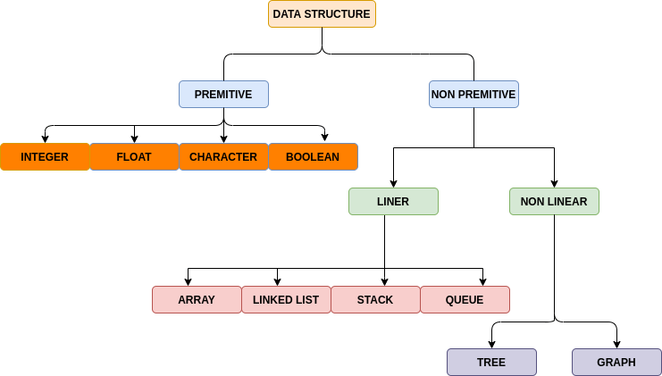
Classification of Data Structure

Slide 12
Classification of Data Structure
Primitive Data Type
Primitive data types are the data types available in most programming languages.
These data types are used to represent single values.
It is a basic data type available in most programming languages.
Non-Primitive Data Type
Data types derived from primary data types are known as Non-Primitive data types.
Non-Primitive data types are used to store groups of values.

Slide 13
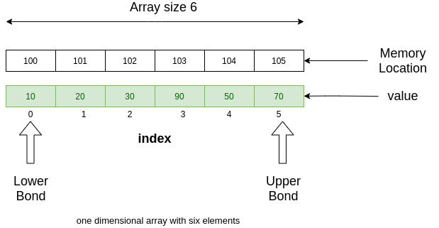
Linear ADTs:
Linear ADTs organize data elements in a linear or sequential manner, where each element has a unique predecessor and successor, except for the first and last elements.
The key characteristic of linear ADTs is the linear relationship between the elements. Some examples of linear ADTs are:
Array
An array is a collection of items stored at contiguous memory locations. The idea is to store multiple items of the same type together. This makes it easier to calculate the position of each element by simply adding an offset to a base value, i.e., the memory location of the first element of the array (generally denoted by the name of the array).

Slide 14
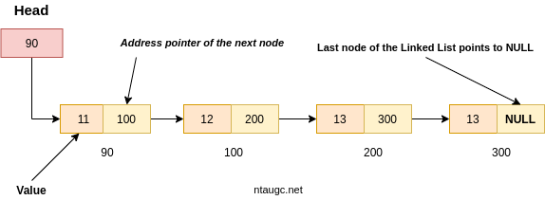
Linear ADTs:
Lists: A list is a collection of elements arranged in a specific order. Elements can be accessed sequentially, and new elements can be added or removed from either end or a specific position within the list. Examples of linear lists include arrays and linked lists.

Slide 15
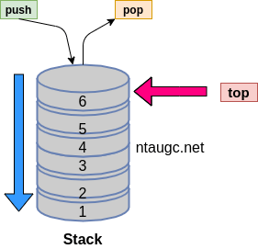
Linear ADTs:
Stacks: A stack is a Last-In-First-Out (LIFO) data structure where elements are added and removed from the same end, called the top. Elements are stacked one on top of the other, and the most recently added element is always the first one to be removed.

Slide 16
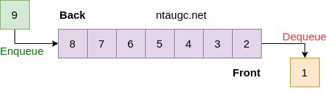
Linear ADTs:
Queues: A queue is a First-In-First-Out (FIFO) data structure that operates on the principle that the element added first is the first one to be removed. Elements are added at the rear and removed from the front.

Slide 17
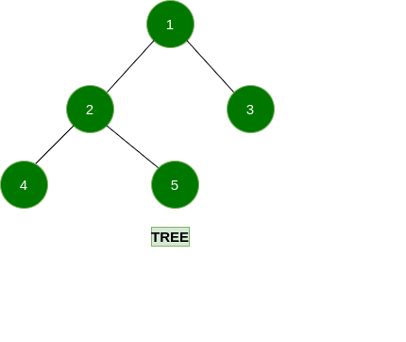
Non-linear ADTs:
Non-linear ADTs: Non-linear ADTs do not have a sequential arrangement of elements. The relationship between elements can be hierarchical, arbitrary, or even cyclical. Some examples of non-linear ADTs are:
Trees: A tree is a hierarchical data structure composed of nodes connected by edges. It has a root node and child nodes, forming a branching structure. Trees can be binary (each node has at most two children) or multiway (each node can have multiple children). Examples include binary trees, AVL trees, and B-trees.

Slide 18
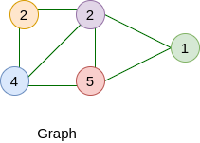
Non-linear ADTs:
Graphs: A graph is a collection of nodes (vertices) connected by edges. Graphs can have arbitrary relationships between nodes, and edges can be directed or undirected. Examples of graphs include directed graphs, undirected graphs, weighted graphs, and social networks.

Slide 19
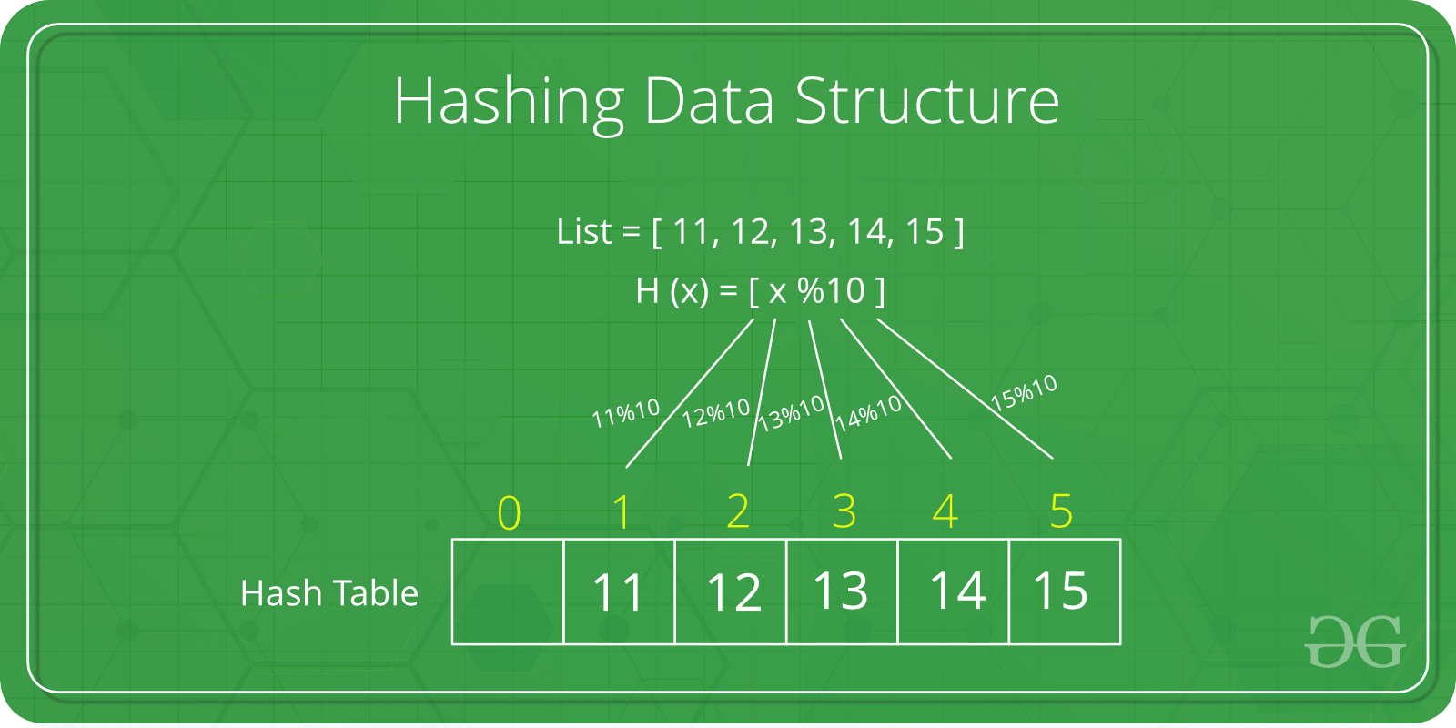
Non-linear ADTs:
Hash Tables: Hash tables use a hash function to map keys to array indices, allowing for efficient key-value storage and retrieval. Hash tables do not have a linear relationship between keys and values.

Slide 20
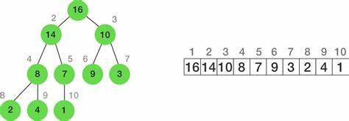
Non-linear ADTs:
Heaps: A heap is a specialized tree-based data structure that satisfies the heap property, which determines the order of elements. Heaps are often used to implement priority queues.

Slide 21
Linear Vs Non-linear Data Structures
Linear Data Structures | Non Linear Data Structures
The data items are arranged in sequential order, one after the other. | The data items are arranged in non-sequential order (hierarchical manner).
All the items are present on the single layer. | The data items are present at different layers.
It can be traversed on a single run. That is, if we start from the first element, we can traverse all the elements sequentially in a single pass. | It requires multiple runs. That is, if we start from the first element it might not be possible to traverse all the elements in a single pass.
The memory utilization is not efficient. | Different structures utilize memory in different efficient ways depending on the need.
The time complexity increase with the data size. | Time complexity remains the same.
Example: Arrays, Stack, Queue | Example: Tree, Graph, Map

Slide 22
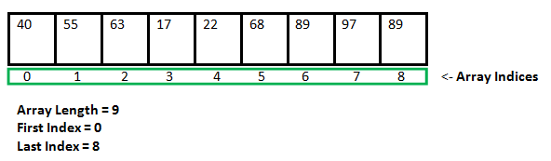
Static Vs Dynamic Data Structures
Data structure is a way of storing and organizing data efficiently such that the required operations on them can be performed be efficient with respect to time as well as memory. Simply, Data Structure are used to reduce complexity (mostly the time complexity) of the code.
Data structures can be two types : 1. Static Data Structure 2. Dynamic Data Structure.
What is a Static Data structure?
In Static data structure the size of the structure is fixed. The content of the data structure can be modified but without changing the memory space allocated to it.

Slide 23
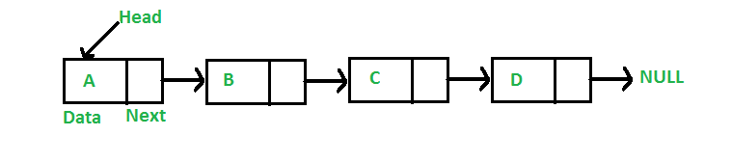
What is Dynamic Data Structure?
In Dynamic data structure the size of the structure is not fixed and can be modified during the operations performed on it. Dynamic data structures are designed to facilitate change of data structures in the run time

Slide 24
Static Vs Dynamic Data Structures
Specification | Static Data Structure | Dynamic Data Structure
Memory allocation | Memory is allocated at compile-time | Memory is allocated at run-time
Size | Size is fixed and cannot be modified | Size can be modified during runtime
Memory utilization | Memory utilization may be inefficient | Memory utilization is efficient as memory can be reused
Access | Access time is faster as it is fixed | Access time may be slower due to indexing and pointer usage
Examples | Arrays, Stacks, Queues, Trees (with fixed size) | Lists, Trees (with variable size), Hash tables

Slide 25
Advantage of Static data structure
Fast access time: Static data structures offer fast access time because memory is allocated at compile-time and the size is fixed, which makes accessing elements a simple indexing operation.
Predictable memory usage: Since the memory allocation is fixed at compile-time, the programmer can precisely predict how much memory will be used by the program, which is an important factor in memory-constrained environments.
Ease of implementation and optimization: Static data structures may be easier to implement and optimize since the structure and size are fixed, and algorithms can be optimized for the specific data structure, which reduces cache misses and can increase the overall performance of the program.
Efficient memory management: Static data structures allow for efficient memory allocation and management. Since the size of the data structure is fixed at compile-time, memory can be allocated and released efficiently, without the need for frequent reallocations or memory copies.
Simplified code: Since static data structures have a fixed size, they can simplify code by removing the need for dynamic memory allocation and associated error checking.
Reduced overhead: Static data structures typically have lower overhead than dynamic data structures, since they do not require extra bookkeeping to manage memory allocation and deallocation.

Slide 26
Advantage of Dynamic Data Structure
Flexibility: Dynamic data structures can grow or shrink at runtime as needed, allowing them to adapt to changing data requirements. This flexibility makes them well-suited for situations where the size of the data is not known in advance or is likely to change over time.
Reduced memory waste: Since dynamic data structures can resize themselves, they can help reduce memory waste. For example, if a dynamic array needs to grow, it can allocate additional memory on the heap rather than reserving a large fixed amount of memory that might not be used.
Improved performance for some operations: Dynamic data structures can be more efficient than static data structures for certain operations. For example, inserting or deleting elements in the middle of a dynamic list can be faster than with a static array, since the remaining elements can be shifted over more efficiently.
Simplified code: Dynamic data structures can simplify code by removing the need for manual memory management. Dynamic data structures can also reduce the complexity of code for data structures that need to be resized frequently.
Scalability: Dynamic data structures can be more scalable than static data structures, as they can adapt to changing data requirements as the data grows.

Slide 27
Operations on different Data Structure
There are different types of operations that can be performed for the manipulation of data in every data structure.
Some operations are explained and illustrated below:
Traversing:
Traversing a Data Structure means to visit the element stored in it. It visits data in a systematic manner. This can be done with any type of DS.
Searching:
Searching means to find a particular element in the given data-structure. It is considered as successful when the required element is found.
Searching is the operation which we can performed on data-structures like array, linked-list, tree, graph, etc.

Slide 28
Operations on different Data Structure
Insertion:
It is the operation which we apply on all the data-structures. Insertion means to add an element in the given data structure. The operation of insertion is successful when the required element is added to the required data-structure.
It is unsuccessful in some cases when the size of the data structure is full and when there is no space in the data-structure to add any additional element.
The insertion has the same name as an insertion in the data-structure as an array, linked-list, graph, tree. In stack, this operation is called Push. In the queue, this operation is called Enqueue.

Slide 29
Operations on different Data Structure
Deletion:
It is the operation which we apply on all the data-structures. Deletion means to delete an element in the given data structure. The operation of deletion is successful when the required element is deleted from the data structure.
The deletion has the same name as a deletion in the data-structure as an array, linked-list, graph, tree, etc. In stack, this operation is called Pop. In Queue this operation is called Dequeue.

Slide 30
Operations on different Data Structure
Create
It reserves memory for program elements by declaring them. The creation of data structure can be done during
Compile-time
Run-time.
You can use malloc() function.
Selection
It selects specific data from present data. You can select any specific data by giving condition in loop .
Update
It updates the data in the data structure. You can also update any specific data by giving some condition in loop like select approach.

Slide 31
Operations on different Data Structure
Sort
Sorting data in a particular order (ascending or descending).
Can take the help of many sorting algorithms to sort data in less time.
Example: bubble sort which takes O(n^2)time to sort data.
There are many algorithms present like merge sort, insertion sort, selection sort, quick sort, etc.
Merge
Merging data of two different orders in a specific order may ascend or descend. We use merge sort to merge sort data.
Split Data
Dividing data into different sub-parts to make the process complete in less time

Slide 32
Algorithms
Find a method or steps that will help you get your work done, we call this method “Algorithm”
In simple terms, Algorithm is a step-by-step process followed to do/accomplish any task.
An algorithm is a set of well-designed, step-by-step instructions designed to solve a problem or perform a specific task.
An algorithm is not the complete code or program, it is just the core logic(solution) of a problem, which can be expressed either as an informal high-level description as pseudocode or using a flowchart.

Slide 33
Categories Of Algorithms
From the data structure point of view, the following are some important categories of algorithms
Search − Algorithm to search an item in a data structure.
Sort − Algorithm to sort items in a certain order.
Insert − Algorithm to insert items in a data structure.
Update − Algorithm to update an existing item in a data structure.
Delete − Algorithm to delete an existing item from a data structure.

Slide 34
Characteristics Of An Algorithm
Not all procedures can be called an algorithm. An algorithm should have the following characteristics:
Input: An algorithm has some input values. We can pass 0 or some input value to an algorithm.
Output: will get one or more outputs at the end of an algorithm.
Unambiguity: An algorithm should be unambiguous which means that the instructions in an algorithm should be clear and simple.
Finiteness: Algorithms must terminate after a finite number of steps.
Effectiveness: An algorithm should be effective with the available resources.
Language independent: An algorithm must be language-independent so that the instructions in an algorithm can be implemented in any of the languages with the same output

Slide 35
Factors of an algorithm
Correctness: An algorithm should produce the correct output for each valid input. It should solve the problem it was designed to address accurately.
Efficiency: Efficiency refers to how well an algorithm utilizes computational resources, such as time and memory. An efficient algorithm typically accomplishes its task in a reasonable amount of time and with minimal resource usage.
Scalability: Scalability relates to how well an algorithm performs as the input size increases. A scalable algorithm maintains its efficiency even when working with larger datasets or more complex problems.
Complexity: Algorithmic complexity describes the computational resources required by an algorithm, typically measured in terms of time complexity (how long it takes to run) and space complexity (how much memory it requires).
Optimality: An optimal algorithm is one that achieves the best possible solution for a given problem. Depending on the problem, optimality may refer to finding the shortest path, the smallest solution, or the highest value, among other criteria.

Slide 36
Factors of an algorithm
6. Maintainability: Maintainability refers to how easy it is to understand, modify, and update an algorithm over time. Well-documented and modular algorithms are easier to maintain and adapt to changing requirements.
7. Robustness: Robustness indicates an algorithm's ability to handle different input conditions, including unexpected or erroneous data. A robust algorithm can gracefully handle edge cases, invalid inputs, or errors during execution.
8. Parallelizability: Parallelizability determines whether an algorithm can be effectively parallelized to take advantage of multiple processors or computing resources. Some algorithms lend themselves well to parallel execution, which can significantly speed up their processing.
9. Security: In certain applications, algorithmic security is crucial. Cryptographic algorithms, for example, need to be resistant to attacks and protect sensitive information.
10. Usability: Usability considers how easily an algorithm can be used by developers or end-users. Clear interfaces, intuitive parameters, and well-designed APIs contribute to an algorithm's usability.
These factors interact with each other and may have trade-offs. Designing an algorithm often involves finding the right balance between these factors based on the specific problem domain and requirements.

Slide 37
Real-life Applications of Data Structures and Algorithms (DSA)
Application of Data Structure
Application of Arrays Application of Strings Application of Matrix Application of Linked Lists Application of Stack Application of Queue Application of Priority Queue Application of Graph Application of Tree Application of Binary Search Tree Application of RED-BLACK Tree Application of AVL Tree Application of SUFFIX Tree Application of TRIE Application of Hash Tables Application of Heap
Application of Algorithms:
Application of Sorting Algorithms Application of Greedy Algorithms Application of Dijkstra Algorithm Application of PRIM’S and KRUSKAL’S Algorithm Application of Dynamic Programming Algorithms Application of Backtracking Algorithms

Slide 38
Application of Arrays
Arrangement of the leaderboard of a game can be done simply through arrays to store the score and arrange them in descending order to clearly make out the rank of each player in the game.
A simple question Paper is an array of numbered questions with each of them assigned some marks.
2D arrays, commonly known as, matrices, are used in image processing.
It is also used in speech processing, in which each speech signal is an array.
Your viewing screen is also a multidimensional array of pixels.
Book titles in a Library Management Systems.
Online ticket booking.
Contacts on a cell phone.
For CPU scheduling in computer.
To store the possible moves of chess on a chessboard.
To store images of a specific size on an android or laptop.

Slide 39
Application of Strings:
Spam email detection.
Plagiarism detection.
Search engine.
Digital forensic and information retrieval system
Spell checkers.
In the database to check valid information of the user

Slide 40
Application of Matrix:
Matrix is an ordered collection of columns and rows of elements. It is necessary to enclose the elements of a matrix within the brackets.
Some applications of a matrix are:
In geology, matrices are used for making seismic surveys.
Used for plotting graphs, and statistics and also to do scientific studies and research in almost different fields.
Matrices are also used in representing real-world data like the population of people, infant mortality rate, etc.
They are the best representation methods for plotting surveys.
For refraction and reflection in science optics.
Electronic circuit and quantum physics.
Media player.
Mailing list.
Symbol table creation.

Slide 41
Application of Linked Lists:
Images are linked with each other. So, an image viewer software uses a linked list to view the previous and the next images using the previous and next buttons.
Web pages can be accessed using the previous and the next URL links which are linked using a linked list.
The music players also use the same technique to switch between music.
To keep the track of turns in a multi-player game, a circular linked list is used.
MS-Paint drawings and shapes are connected via a linked list on canvas.
Social media content “feeds”.
Used for symbol table management in a designing compiler
Used in switching between applications and programs (Alt + Tab) in the Operating system (implemented using Circular Linked List)
Train coaches are connected to one another in a doubly-linked list fashion.
It can be used to implement Stacks, Queues, Graphs, and Trees.
To perform undo operation.
Back button.[LIFO]
Syntax in the coding editor.
History of visited pages.

Slide 42
Application of Stack
Converting infix to postfix expressions.
Undo/Redo button/operation in word processors.
Syntaxes in languages are parsed using stacks.
It is used in many virtual machines like JVM.
Forward-backward surfing in the browser.
History of visited websites.
Message logs and all messages you get are arranged in a stack.
Call logs, E-mails, Google photos’ any gallery, YouTube downloads, Notifications ( latest appears first ).
Scratch card’s earned after Google pay transaction.
Wearing/Removing Bangles, Pile of Dinner Plates, Stacked chairs.
Changing wearables on a cold evening, first in, comes out at last.
Last Hired, First Fired - which is typically utilized when a company reduces its workforce in an economic recession.
Loading bullets into the magazine of a gun. The last one to go in is fired first. Bam!
Java Virtual Machine.
Recursion.
Used in IDEs to check for proper parentheses matching
Media playlist. T o play previous and next song

Slide 43
Application of Queue:
Operating System uses queues for job scheduling.
To handle congestion in the networking queue can be used.
Data packets in communication are arranged in queue format.
Sending an e-mail, it will be queued.
Server while responding to request
Uploading and downloading photos, first kept for uploading/downloading will be completed first (Not if there is threading)
Most internet requests and processes use queue.
While switching multiple applications, windows use circular queue.
In Escalators, Printer spooler, Car washes queue.
A circular queue is used to maintain the playing sequence of multiple players in a game.
A queue can be implemented in - Linked List-based Queue, Array-based Queue, Stack-based Queue.
Uploading and downloading photos, first kept for uploading/downloading will be completed first (Not if there is threading).
Handle website traffic
CPU scheduling

Slide 44
Application of Priority Queue:
Process scheduling in the kernel.
Priority queues are used in file-downloading operations in a browser
Vehicle at the toll center.

Slide 45
Application of Graph:
Facebook’s Graph API uses the structure of Graphs.
Google’s Knowledge Graph also has to do something with Graph.
Dijkstra algorithm or the shortest path first algorithm also uses graph structure to find the smallest path between the nodes of the graph.
The GPS navigation system also uses shortest path APIs.
Networking components have a huge application for graph
Facebook, Instagram, and all social media networking sites every user is Node
Data organization
React’s virtual DOM uses graph data structures.
MS Excel uses DAG (Directed Acyclic Graphs).
Path Optimization Algorithms, BFS, DFS.
Recommendation Engines.
Scientific Computations, Flight Networks, Page ranking.
Google map to find nearest location.
Facebook to suggest mutual friends

Slide 46
Application of Tree
XML Parser uses tree algorithms.
The decision-based algorithm is used in machine learning which works upon the algorithm of the tree.
Databases also use tree data structures for indexing.
Domain Name Server(DNS) also uses tree structures.
File explorer/my computer of mobile/any computer
BST used in computer Graphics
Posting questions on websites like Quora, the comments are a child of questions.
Parsers(XML parser).
Code Compression(zip).
DOM in Html.
Evaluate an expression (i.e., parse).
Integral to compilers/automata theory.
To store the possible moves in a chess game.
To store the genealogy information of biological species.
Used by JVM (Java Virtual Machine) to store Java objects.

Slide 47
Application of Binary Search Tree:
D Game Engine.
Computer Graphics Rendering.
Routing table.
Application of RED-BLACK Tree
Used when there is frequent Insertion/Deletion and few searches.
K -mean Clustering using a red-black tree, Databases, Simple-minded database, searching words inside dictionaries, searching on the web.
Process Scheduling in Linux.
Application of AVL Tree
More Search and less Insertion/Deletion.
Data Analysis and Data Mining and the applications which involve more searches.
Application of SUFFIX Tree
Fast full-text search, used in most word processors.
Application of TRIE
Dictionary application.
Autocomplete feature in searching.
Auto-completing the text and spells checking.

Slide 48
Application of Hash Tables
Data stored in databases is generally of the key-value format which is done through hash tables.
Every time we type something to be searched in google chrome or other browsers, it generates the desired output based on the principle of hashing.
Message Digest, a function of cryptography also uses hashing for creating output in such a manner that reaching the original input from that generated output is almost next to impossible.
In our computers we have various files stored in it, each file has two very crucial pieces of information that is, the filename and file path, in order to make a connection between the filename to its corresponding file path hash tables are used.
Social network “feeds”.
Password hashing.
Used for fast data lookup - symbol table for compilers, database indexing, caches, Unique data representation.
To store a set of fixed keywords that are referenced very frequently.

Slide 49
Application of Heap:
In heapsort Algorithm, is an algorithm for sorting elements in either min heap(the key of the parent is less than or equal to those of its children) or max heap(the key of the parent is greater than or equal to those of its children), sorting is done with the creation of heaps.
Heaps are used to implementing a priority queue where priority is based on the order of heap created.
Systems concerned with security and embedded system such as Linux Kernel uses Heap Sort because of the O(n log(n) ).
If we are stuck in finding the K^{th}smallest (or largest) value of a number then heaps can solve the problem in an easy and fast manner.
Used by JVM (Java Virtual Machine) to store Java objects.

Slide 50
Application of Algorithms:
Application of Sorting Algorithms
Order things by their value.
Backend Databases (Merge Sort).
Playing Cards with your friends (Insertion Sort).
sort() - uses IntroSort (a hybrid of Quicksort, Heapsort, and Insertion Sort), Faster than qsort()
The contact list on the phone
Online shopping. To sort prize in different range . example : flipkart and amazon.
Application of Greedy Algorithms:
Dijkstra algorithm.
Shopping on a tight budget but want to buy gifts for all family members.
Prim’s and Kruskal’s algorithms are used for finding the minimum spanning trees.

Slide 51
Application of Dijkstra Algorithm
Used in applications like Google Maps to find the shortest path in a graph.
Application of PRIM’S and KRUSKAL’S Algorithm
Used for finding the minimum spanning trees.
Application of Dynamic Programming Algorithms:
In Google Maps to find the shortest path between the source and the series of destinations (one by one) out of the various available paths.
In networking to transfer data from a sender to various receivers in a sequential manner.
Application of Backtracking Algorithms:
Suppose we are coding a chess-playing algorithm and at a certain point, the algorithm finds that a set of steps fails to win. In this situation, the algorithm will reverse back to the safe state and try another possible set of steps.
Sudoku solver
2048 game
Computer networking.
To solve problem of the N Queen.
To solve the problem of the Maze.
To find the Hamiltonian Path present in a graph.
To the love problem of Knight’s Tour Problem.

